Slide 1
Presentation on Flume
Efforts by :- Gurpreet Singh Sahni

Slide 2
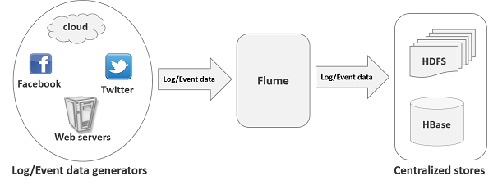
About Flume :-
Apache Flume is a tool/service/data ingestion mechanism for collecting aggregating and transporting large amounts of streaming data such as log files, events (etc...) from various sources to a centralized data store.
Flume is a highly reliable, distributed, and configurable tool. It is principally designed to copy streaming data (log data) from various web servers to HDFS.

Slide 3
Features
Flume ingests log data from multiple web servers into a centralized store (HDFS, HBase) efficiently.
Using Flume, we can get the data from multiple servers immediately into Hadoop.
Flume supports a large set of sources and destinations types.
Advantages
Using Apache Flume we can store the data in to any of the centralized stores (HBase, HDFS).
Flume provides the feature of contextual routing.
Flume is reliable, fault tolerant, scalable, manageable, and customizable.

Slide 4
Fetching twitter data

Slide 5
About the project :-
In this project, I will explain how to fetch data from Twitter service and store it in HDFS using Apache Flume.
I will create an application and get the tweets from it using the experimental twitter source provided by Apache Flume. We will use the memory channel to buffer these tweets and HDFS sink to push these tweets into the HDFS.

Slide 6
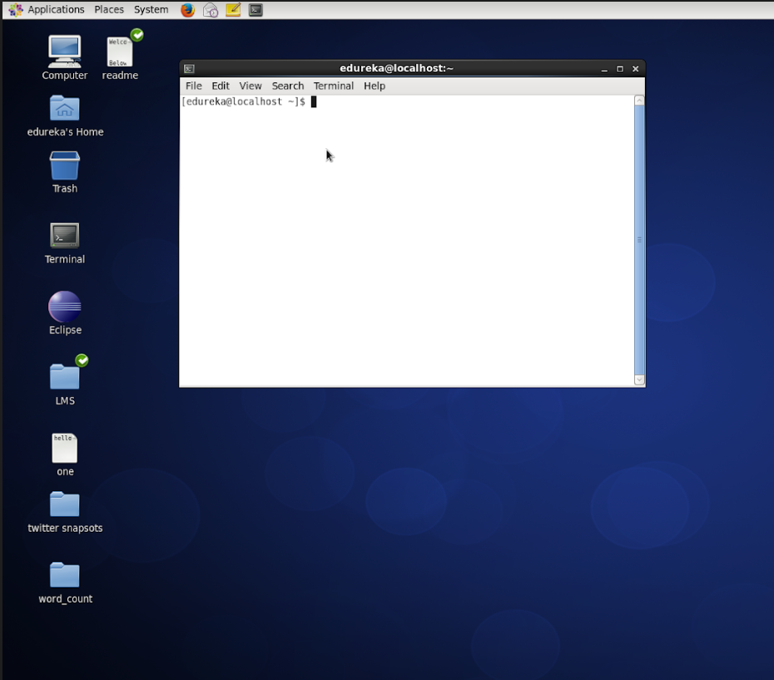
Step 1: Start the terminal

Slide 7
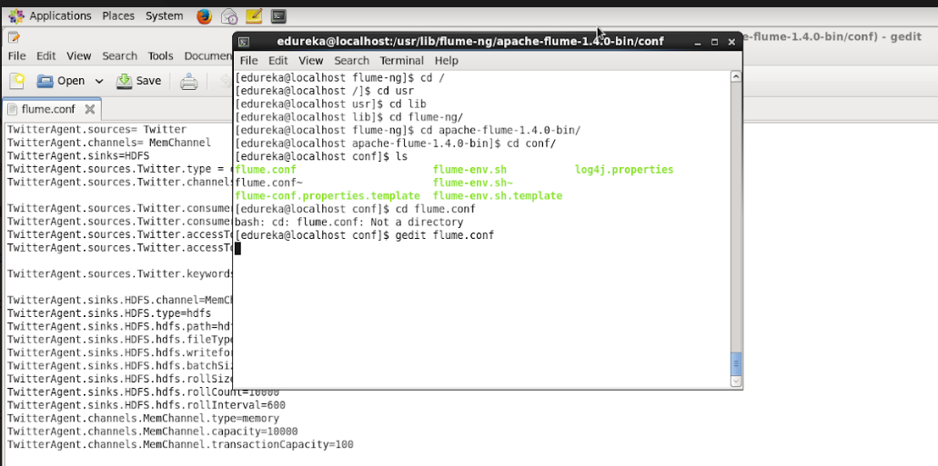
Step 2 : Go to Directory > /usr/lib/flume-ng/apache-flume-1.4.0-bin/conf and open flume.conf in a text editor

Slide 8
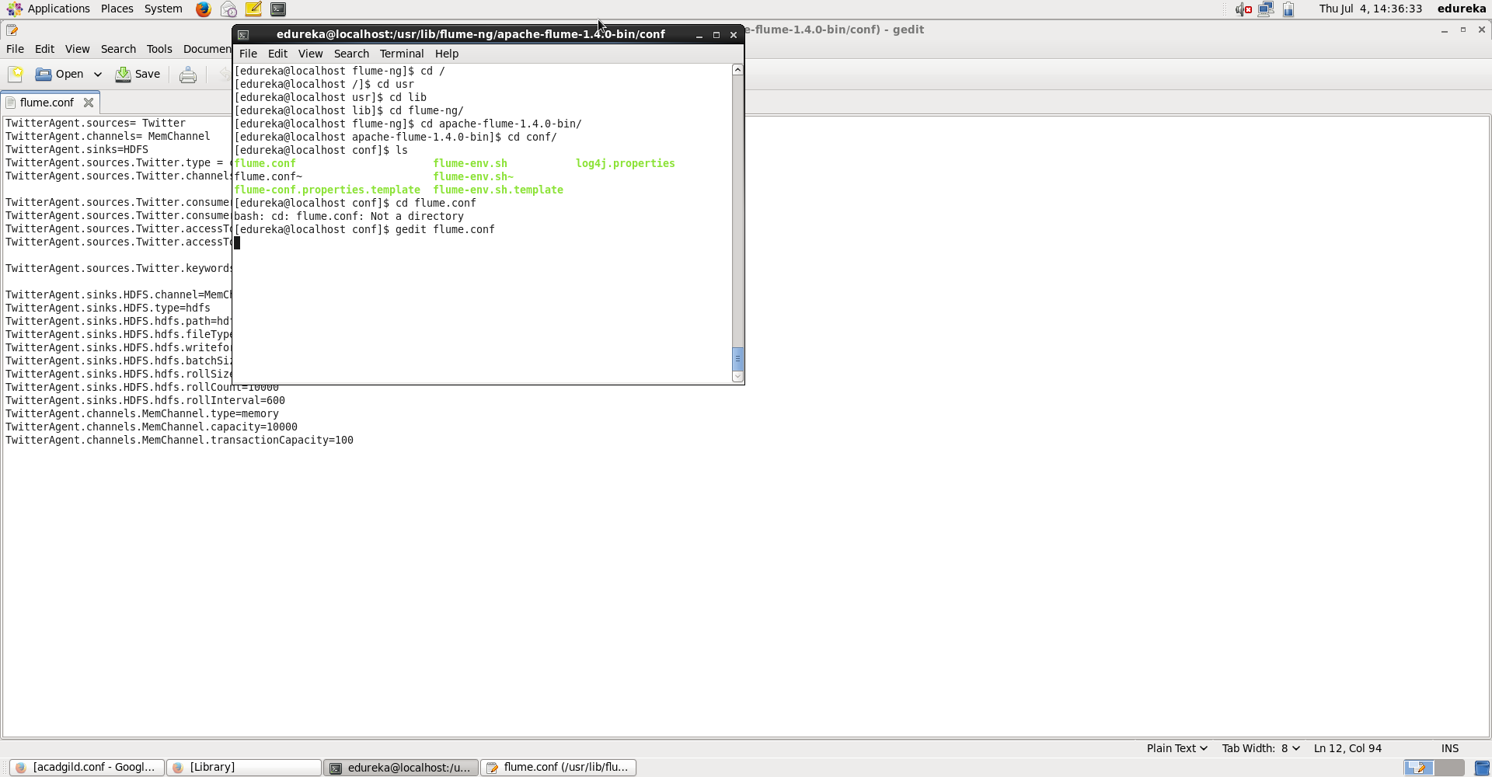

Step 3: Replace the keys and add some new keywords given in the file

Slide 9
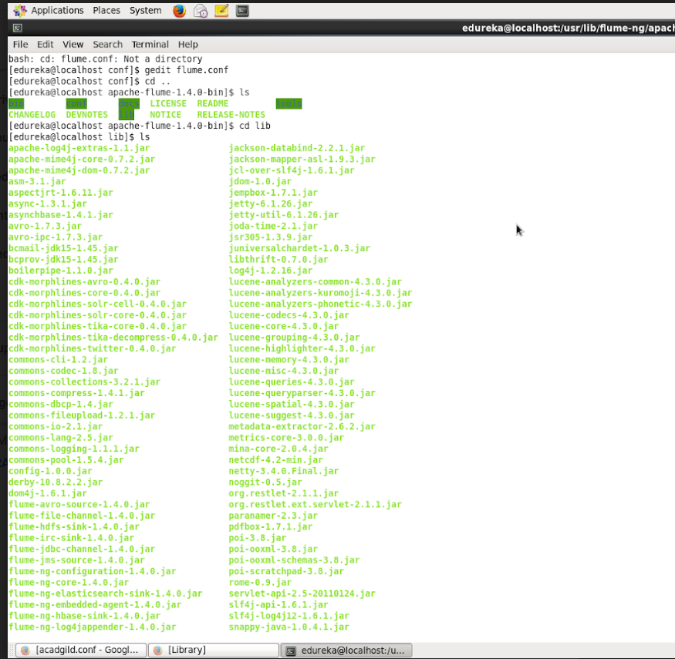
Step 4: Now move to/usr/lib/flume-ng/apache-flume-1.4.0-bin/bin/ and replace the jar file to configure flume

Slide 10
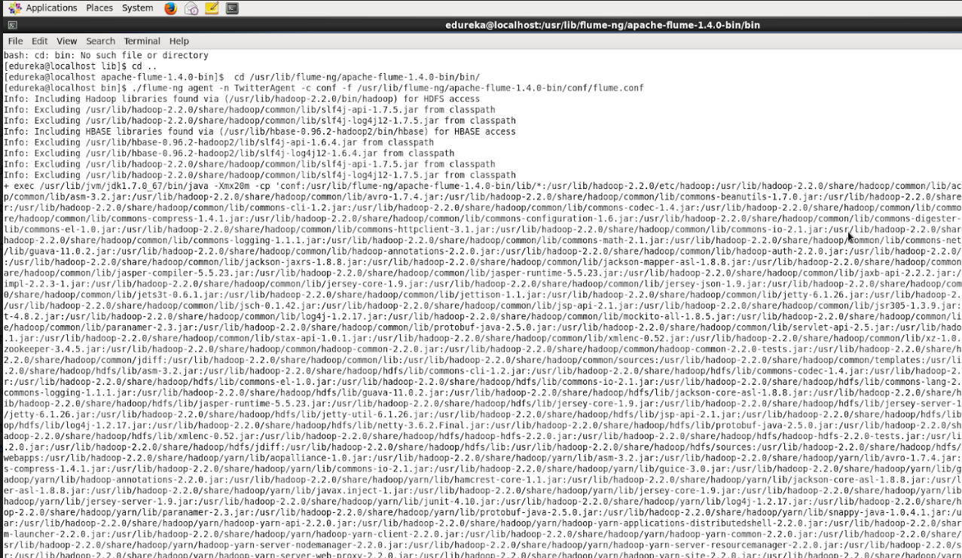
Step 4: Again open terminal and run commands as given in snapshot

Slide 11
Step 5: After completion, Open browser....type localhost then go to location given in snapshot

Slide 12
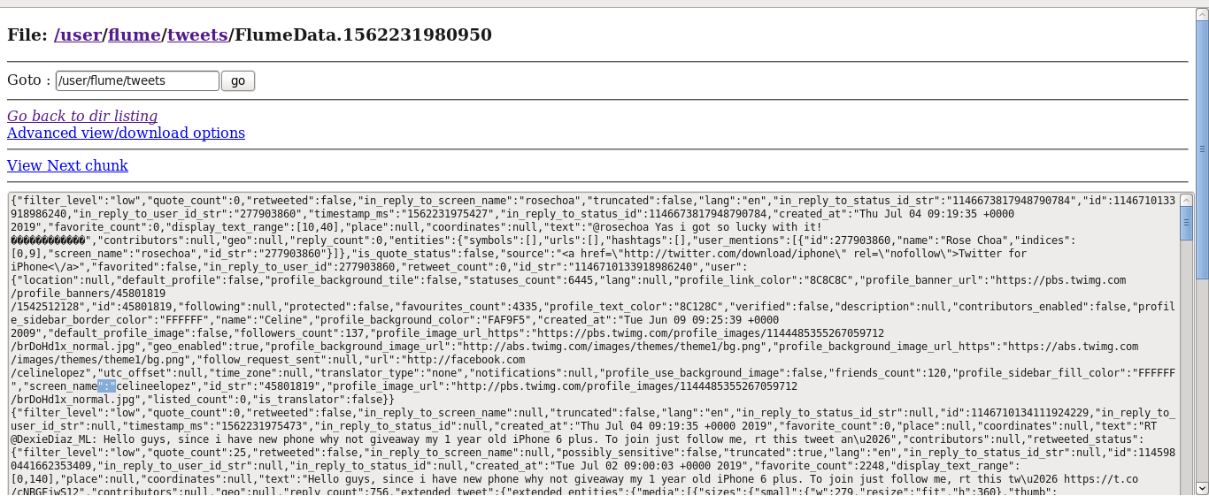
Step 6: Look for the recently created file and open it.
The tweets with the
matching key
words
are shown here

Slide 13


